Slide 1
UK per capita electricity consumption is a bit below the EU average
Electricity consumption in European countries
kWh/person, 2017

Slide 2
The UK electricity market value chain is a best practice for all EU countries
Generation
Transmission
Distribution
Retail
~330 TWh
>100 companies
Part of international energy groups (except Drax)
Cleantech targets + investment promotion → Share of renewable is growing fast
Owned and maintained by regional TSOs (17 licensees), mainland is covered by 3 companies
System Operator is National Grid)
> 25,000 km
Natural monopolies → regulated tariff system: revenue cap
4 GW existing interconnection + 7 GW planned
14 British DNO (6 energy groups)
~837,000 km
Natural monopolies → regulated tariff system: revenue cap
Multi-billion investment needed to upgrade to smart grid
Fully open market since 1999
Number of active suppliers: ~60, Big6 + few others dominating the market
Prices: bilateral negotiations / supplier tariff schemes
Regulator intervenes to increase competition and supply security

Slide 3
The UK electricity market value chain is a best practice for all EU countries
Generation
Transmission
Distribution
Retail
~330 TWh
>100 companies
Part of international energy groups (except Drax)
Cleantech targets + investment promotion → Share of renewable is growing fast
Owned and maintained by regional TSOs (17 licensees), mainland is covered by 3 companies
System Operator is National Grid)
> 25,000 km
Natural monopolies → regulated tariff system: revenue cap
4 GW existing interconnection + 7 GW planned
14 British DNO (6 energy groups)
~837,000 km
Natural monopolies → regulated tariff system: revenue cap
Multi-billion investment needed to upgrade to smart grid
Fully open market since 1999
Number of active suppliers: ~60, Big6 + few others dominating the market
Prices: bilateral negotiations / supplier tariff schemes
Regulator intervenes to increase competition and supply security

Slide 4
Total electricity generation reached 330 TWh in 2017
Electricity generation fuel mix in the UK
Electricity generation supplier market shares in the UK, 2017, generated volume
378 TWh
~330 TWh
90 GW installed capacity
* First three quarters of 2018

Slide 5
A deeper look into renewable energy in the UK
Renewable electricity generation , Q1 2018
93 TWh generated in 2017
41.9 GW capacity
Increasing government projects to grow renewable generation
Significant reduction of renewable energy cost for final consumers
* First three quarters of 2018

Slide 6
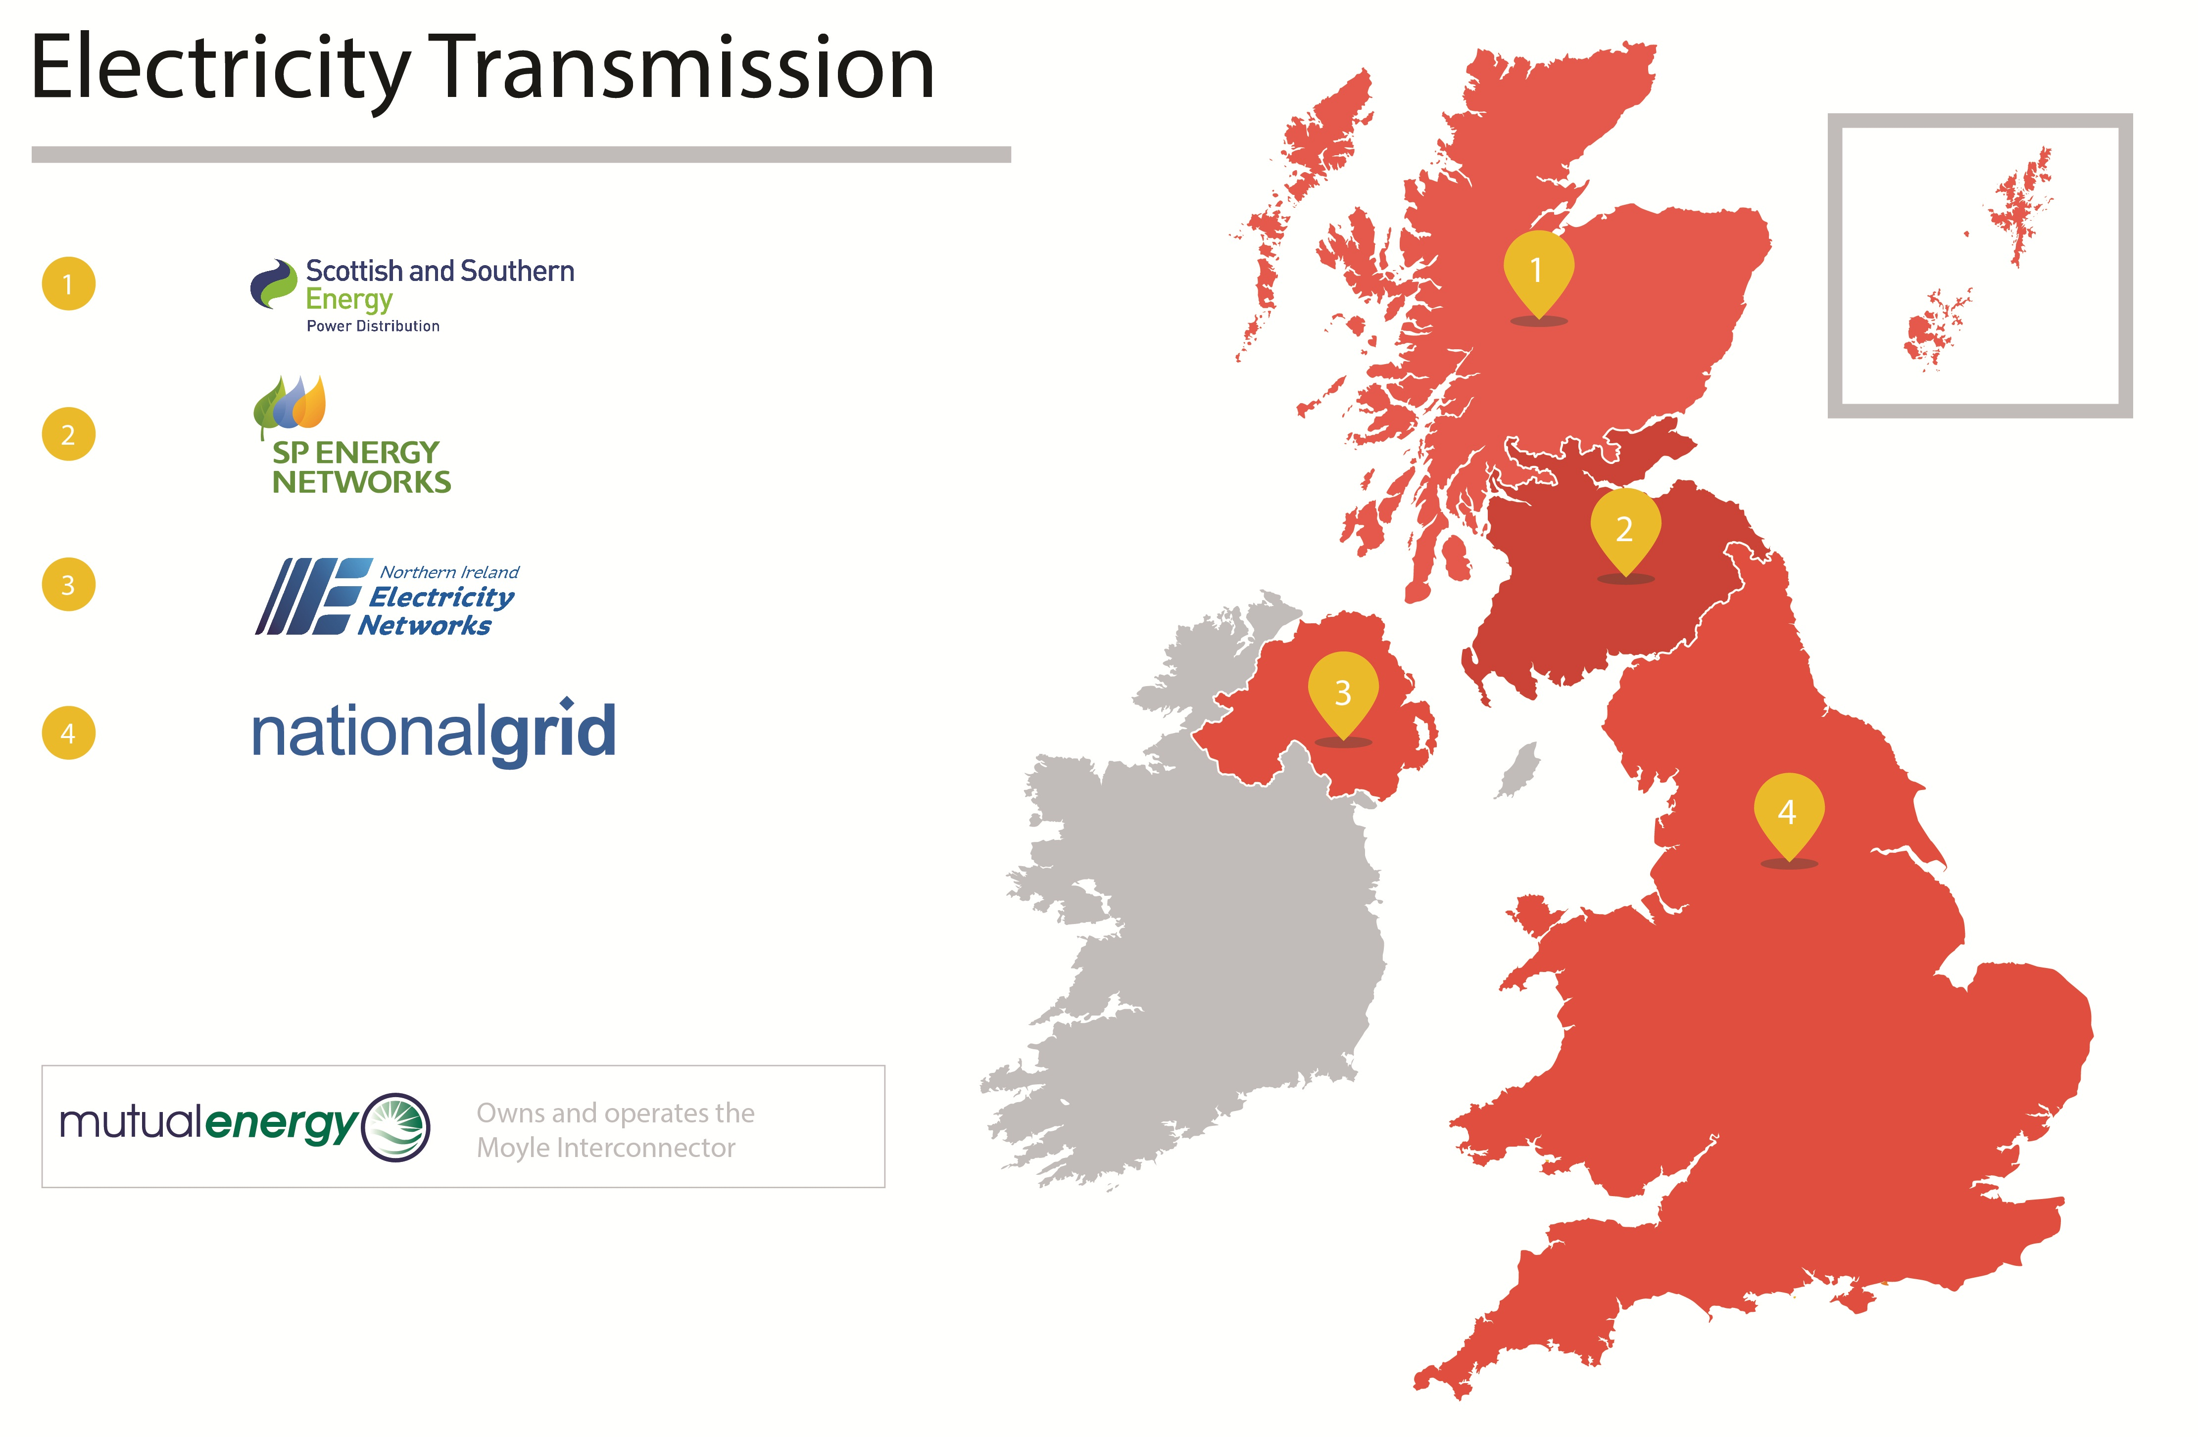

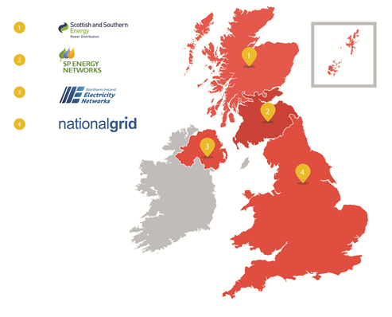
Mainland transmission operation is performed by a few companies, limiting competition
Few natural monopolies
Prices: fully regulated, revenue cap
Three types of charges: Connection charges, TNUoS, BSUoS, payable to the System Operator
OFGEM as regulator
Ambitious renewable government targets. For offshore wind, offshore transmission system needs to be developed

Slide 7
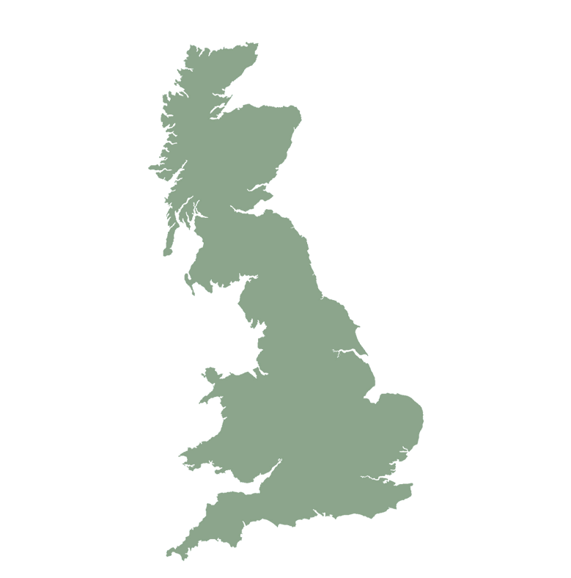






Currently 4 GW interconnection capacity is existing, to be ~doubled by 2022, most of them regulated by ‚cap and floor’ regime
Existing
In Development
1.4 GW
~5% of UK’s electricity is imported through interconnectors
0.5 GW
1.4 GW
1 GW
0.5 GW
1 GW
2 new Interconnectors expected to operate in 2019 (1 FR, 1 BEL)
0.5 GW
Exports between 1-3 % of UK’s consumption
2 GW
3.4 GW
3 int. planned

Slide 8
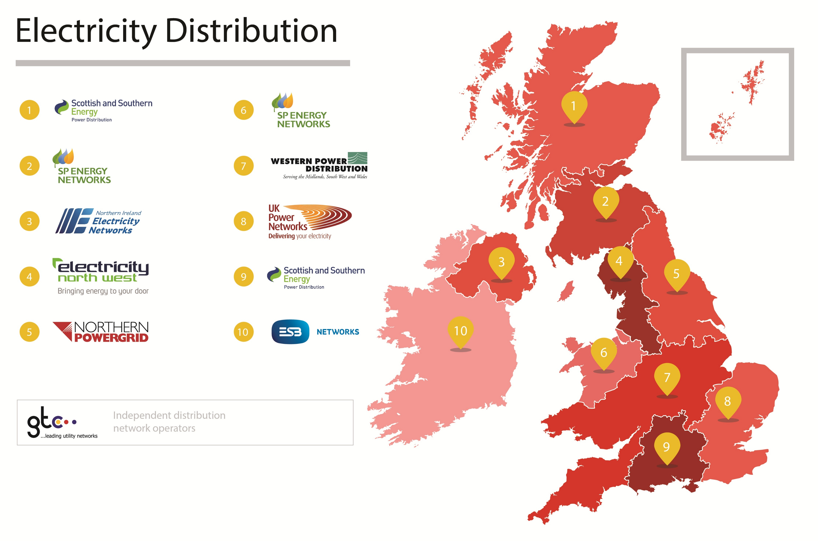
The task of distribution network operation is allocated to several companies, on a regional basis
14 licensed DNOs in Britain with regional split (owned by six groups) + 1 ROI and 1 Northern Ireland.
8 smaller networks owned and operated by Independent Network Operators (IDNOs), located within the areas of DNOs
Price control: RIIO revenue cap: Revenue = Incentives + Innovation + Outputs
Distribution charges (Connection charges, Unit Charge, Capacity Charge, Standing Charge) paid to the DNOs, via the supplier

Slide 9
The UK retail power market is fully competitive, especially in the non-domestic segment
Electricity market share of suppliers in the UK, June 2018
Domestic
Non-domestic HH
Non-domestic NHH
Fully open market with ease of switching
Generators / wholesale market → suppliers → end consumer
Suppliers set prices: Bilaterally negotiations or tariff schemes
OFGEM: increase competition and enforce rules (monitoring, intervention)
35% electricty demand comes from domestic customers and 65% from non-domestic.
~30.5 million electricity meters in the country
~64 suppliers present on the market actively

Slide 10
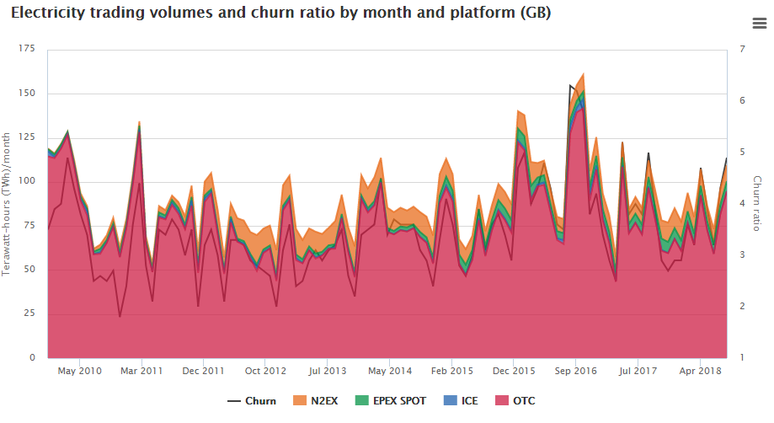
Suppliers source the energy used by end consumers from the wholesale market or generators
Suppliers, generators, traders and customers trade in the wholesale market
Trading: bilaterally or on exchanges: Spot prices (Day-Ahead - Years-Ahead) forward purchasing (OTC)
National Grid: ‘residual balancer’ of the electricity system (System Marginal Price)
OFGEM: policy and incentive schemes to maintain and increase market liquidity
Virtually no customer transaction limits, almost acting as a trader, accessing all available markets
The chart shows total monthly volumes of electricity traded in GB across different trading platforms. The churn ratio is also shown. ‘Churn’ is the number of times one unit of electricity is traded.

Slide 11
UK large consumers pay the second highest price for power in Europe
Cost of electricity in European countries
€/kWh, 2018 S1, consumption band 70-150 GWh / year
Low level of interconnectivity, expensive government projects keep the UK electricity price high; for the same reasons the landscape is not likely to change
EU average

Slide 12
Non-commodity costs give ~56% of the invoice value for an average UK electricity non-domestic customer
Comodity Cost: Wholesale commodity market price
Taxes exc. VAT: Climate Change Levy (CCL) - 100%
Third Party (Regulated) Charges: BSUOS, RO, Hydro, Elexon, FiT, CfD, Capacity Market, etc.)
Transportation & Distribution Cost: Network costs, Losses
Supplier Specific charges: Margin (Management, Shape and Imbalance fees)

